Slide 1
Regression

Slide 2
Regression Analysis
Regression analysis: A set of statistical techniques used to estimate the relationships between a dependent variable and one or more independent variables
This allows us to:
A) Quantify the relationship between variables.
Example: What is the relationship between housing price and size?
B) Predict the values of one variable given the values of another.
Example: How expensive will a house that has 2,000 sqft be?
C) Test hypotheses about relationships between variables.
Example: Does proximity to a park / power plant make a home more / less valuable?

Slide 3
Variables
Dependent variable: The variable we are attempting to predict or explain
Independent variable(s): The variables we are using to predict or explain our dependent variable
Dependent Variable | Independent Variables
Price | Square feet, # of bedrooms, # of bathrooms….
Homicides | Average prison sentence, number of police…
Sales | Price, advertising budget, sales promotion…

Slide 4
Simple Linear Regression
Y = B0 + B1X + E
Y: The dependent variable
X: The independent variable
B0: The constant value (Y-intercept)
B1: The slope value
E: Stochastic error term

Slide 5
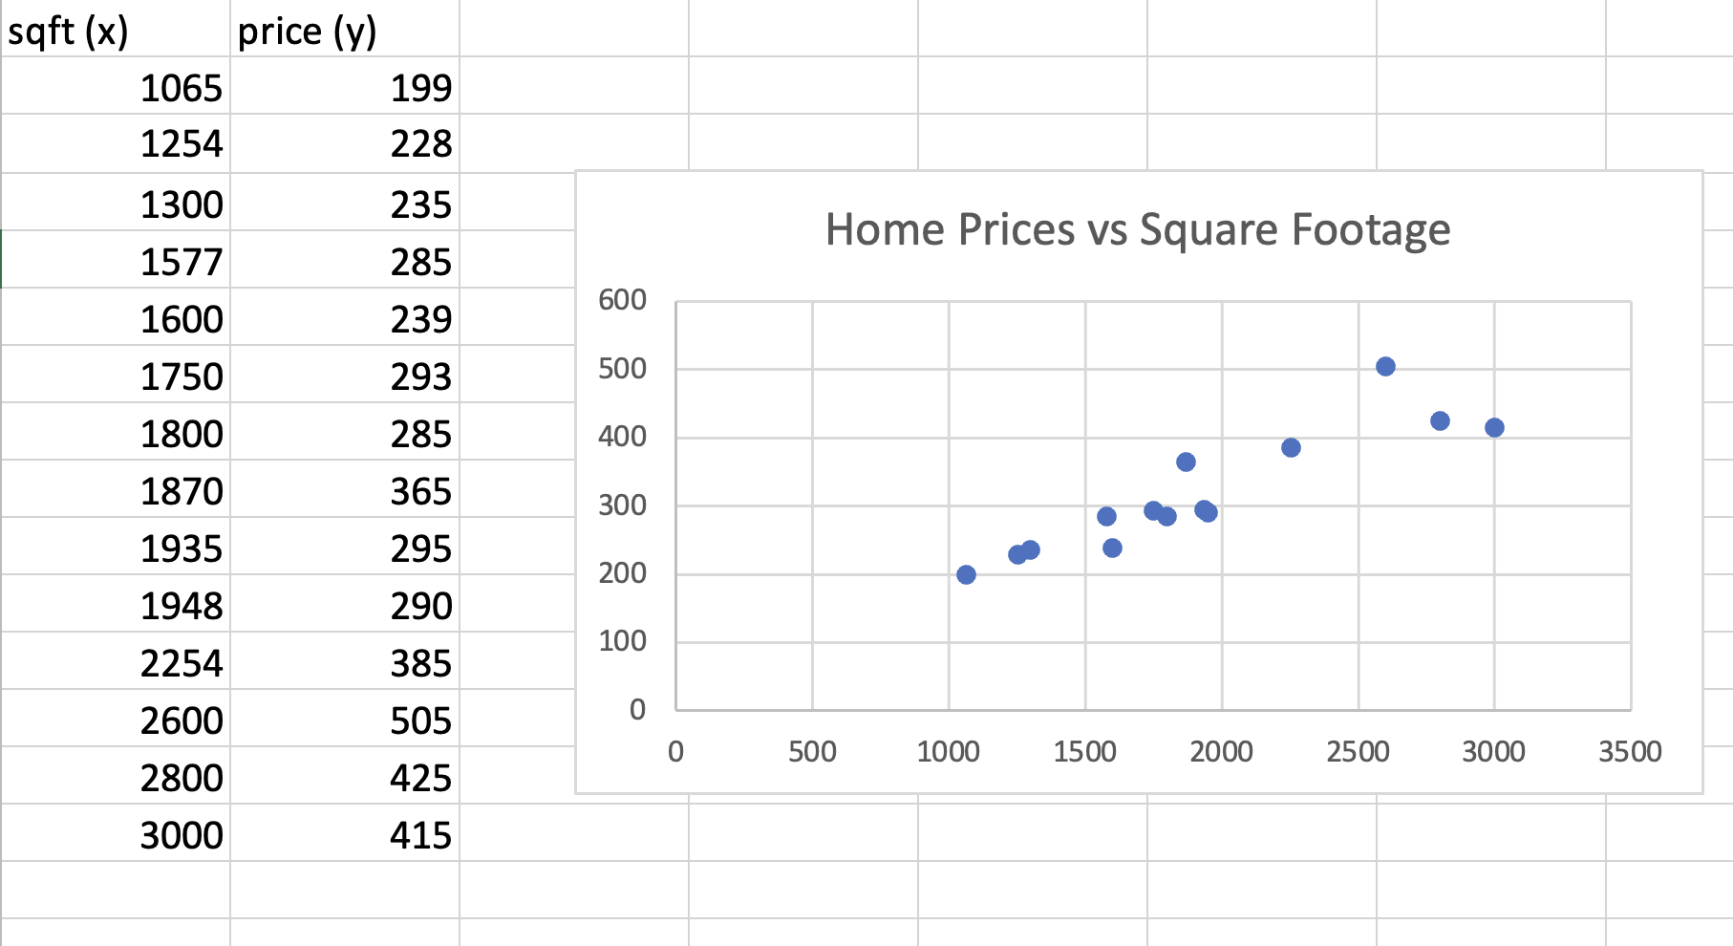
Regression
Notes:
https://docs.google.com/spreadsheets/d/1wqjOjf7lZ38MH8qTfnSt7Mgys-fS0sdpJRLiyVBBWIQ/edit?usp=sharing

Slide 6
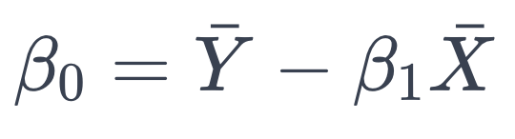
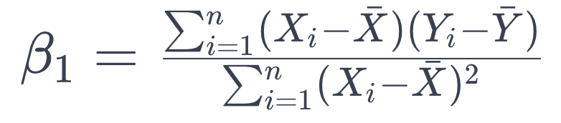
Regression Math

Slide 7
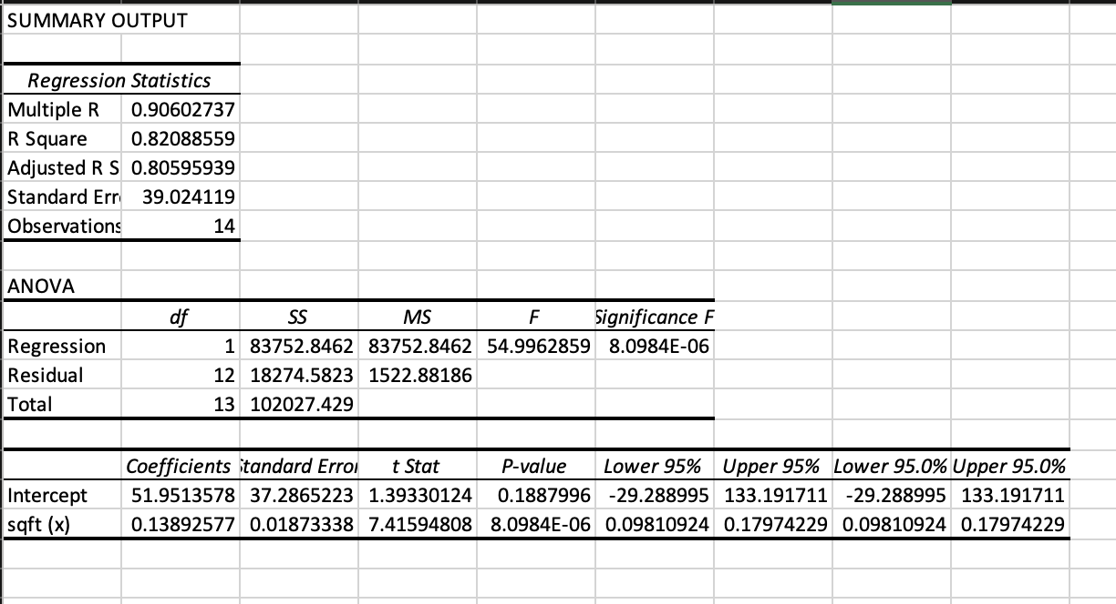
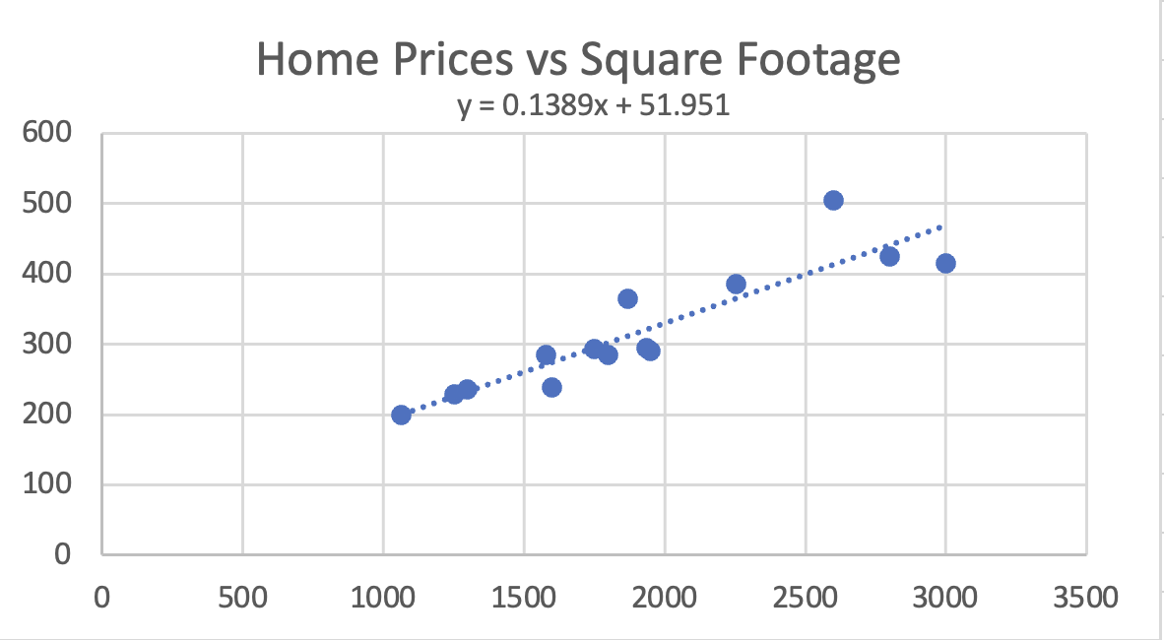
Regression With Software!

Slide 8
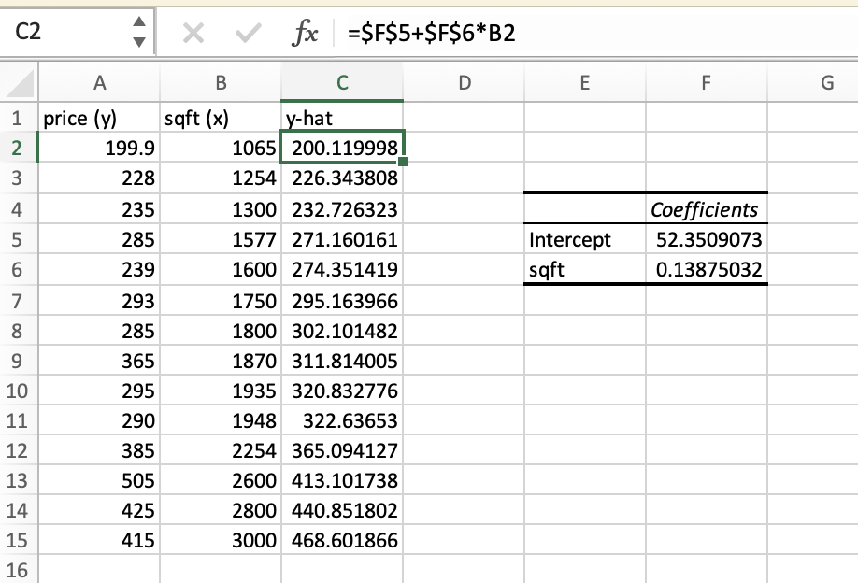
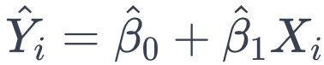
Fitted Values / Predicted Values / Y-Hat
Fitted values are the estimated values of the dependent variable given each value of the independent variable(s)

Slide 9
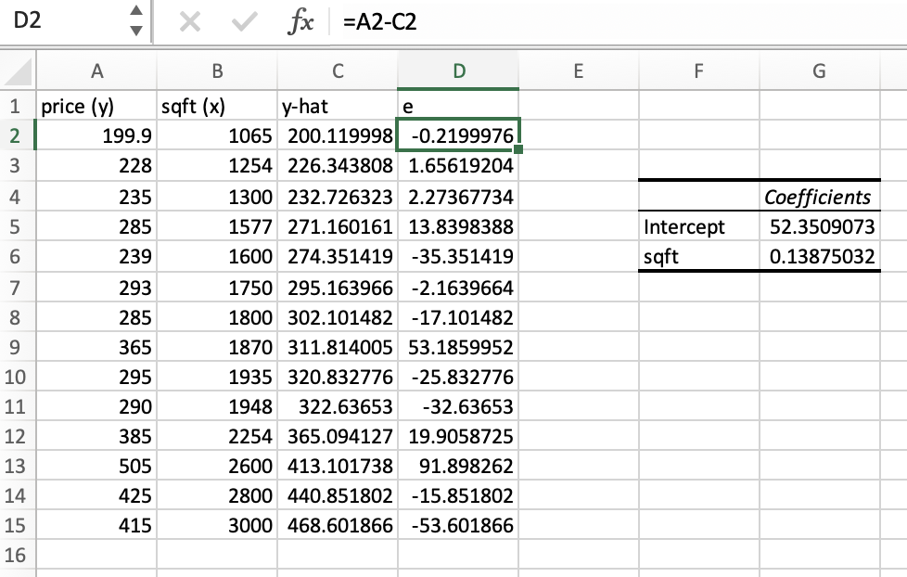
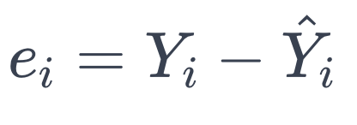
Residuals / Errors
Residuals are the difference between the actual values of the dependent variable (Y) and the predicted values of the dependent variable (Y-hat)

Slide 10
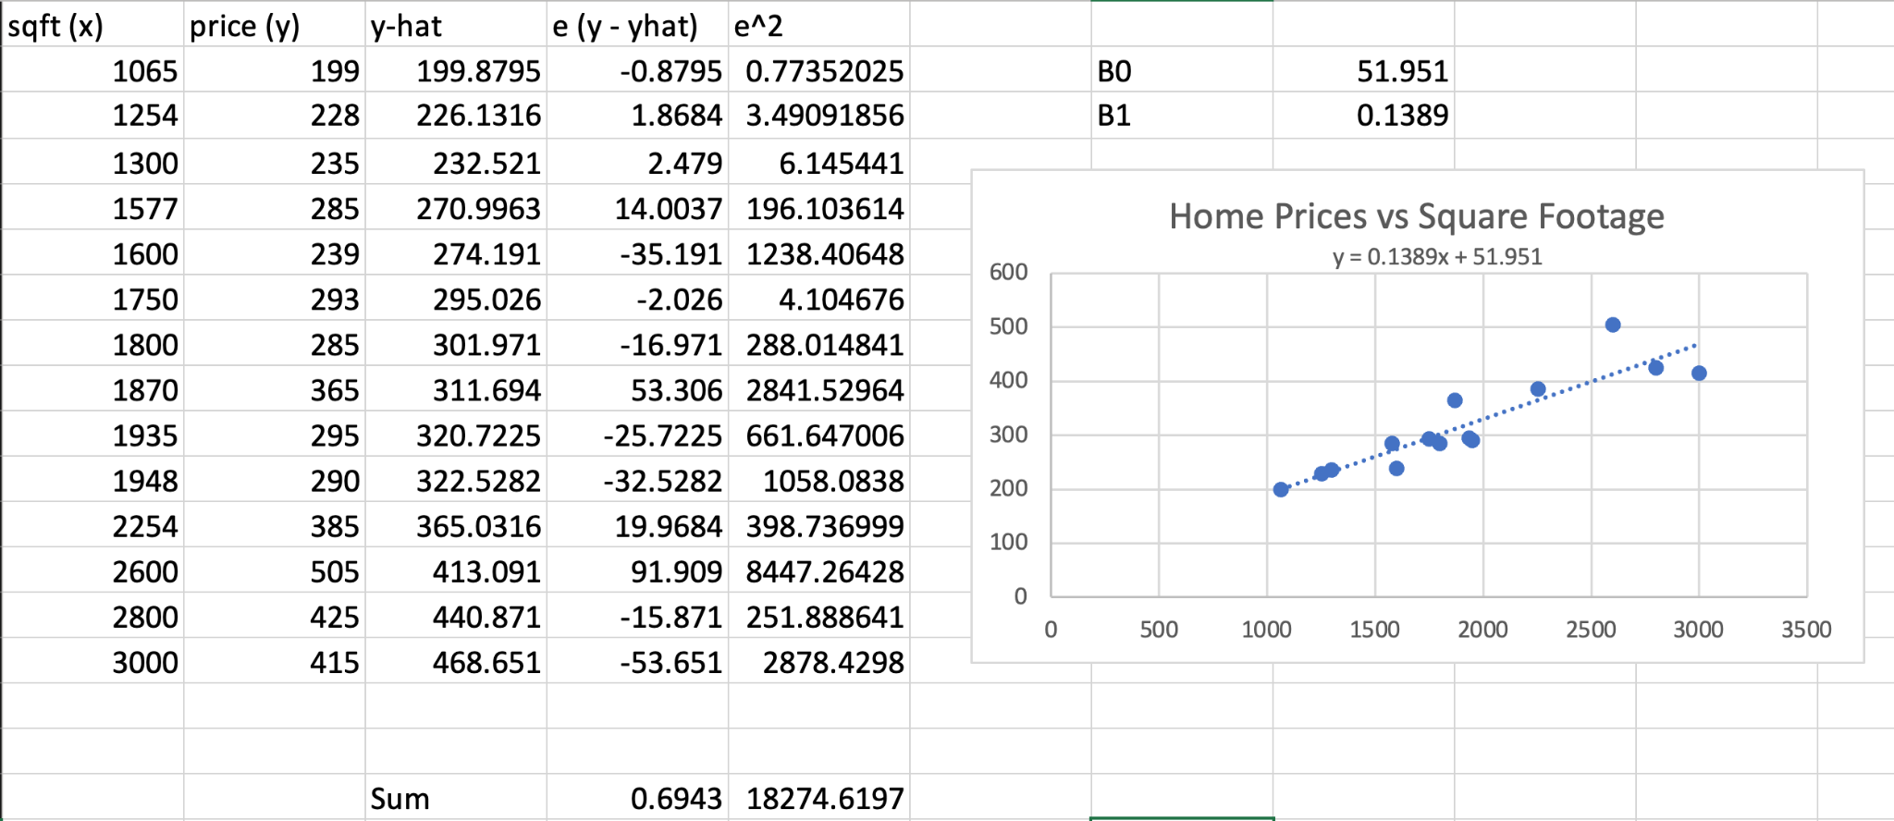
Regression
Notes:
https://docs.google.com/spreadsheets/d/1wqjOjf7lZ38MH8qTfnSt7Mgys-fS0sdpJRLiyVBBWIQ/edit?usp=sharing

Slide 11
Simple Regression Interpretation
B0: The value of the dependent variable when the independent variable equals zero (not always a coherent interpretation)
B1: The change in the dependent variable associated with a single unit increase in the independent variable
Price (Thousands of Dollars) = 51.951 + 0.1389 * Square Feet
B0: 51.951 - When a house has zero square footage, price is equal to $51k
B1: 0.1389 - A single additional square foot is worth $138.9

Slide 12
Regression Prediction
To predict values of the dependent variable using a regression equation, plug values in for the independent variable(s) in the estimated regression equation
Price = 50.951 + 0.1389 * Square Footage
When square feet = 1000, price equals…?
50.951 + 0.1389 * 1000 = 189.851
When square feet = 2000, price equals…?
50.951 + 0.1389 * 2000 = 328.751
Be careful when using or estimating values outside of the range of your sample. The relationships that exist within your sample may not exist outside of it!

Slide 13
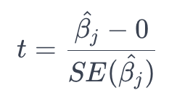
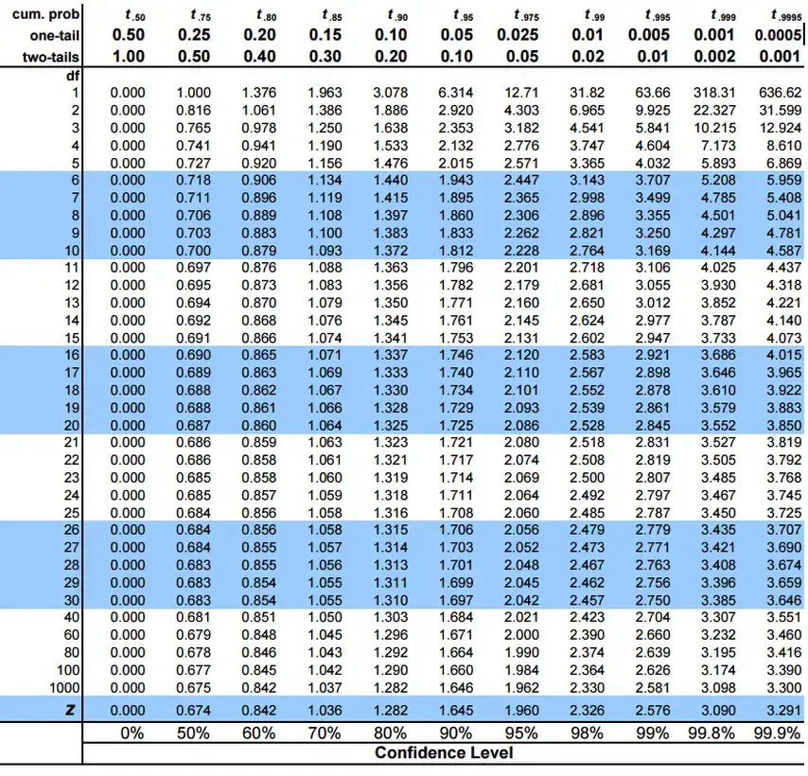
Testing Hypotheses / Statistical Significance
To test that a given regression coefficient is different than zero (or any other value) to a statistically significant extent:
1) Calculate the t-value for a given coefficient using the formula.
2) Find the appropriate critical value using a t-table or software
Degrees of freedom = n - k - 1
3) If the absolute value of T > CV, reject the null hypothesis that there is no significant difference from zero (or something else)

Slide 14
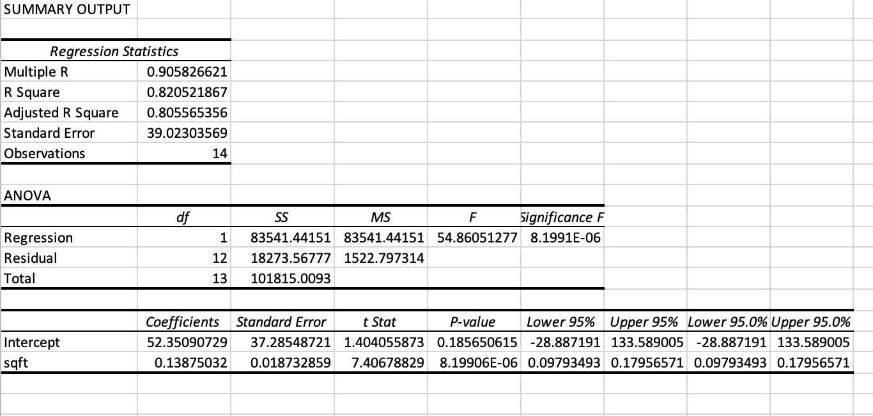
Understanding Regression Output
Beta Coefficient(s): The relationship between the X variables and Y variable (holding other variables constant*)
R^2*: The percentage of variation in Y explained by X
Adjusted R^2: R^2, but penalized for the inclusion of potentially irrelevant variables
P-Values: The p-value associated with the null-hypothesis that the regression coefficient is actually equal to zero (meaningless)
Confidence Intervals: Bands around which we can be 95% confident the true value is***

Slide 15
R-Squared (R^2)
Total Sum of Squares (SST) = Variation of Y values around their Mean
= Sum((Yi - Y-Bar)^2)
Regression Sum of Squares (SSR) = Variation attributable to the relationship between X and Y
= Sum((Y-Hat - Y-Bar)^2)
Error Sum of Squares (SSE) = Variation in Y attributable to factors other than X
= Sum((Yi - Y-Hat)^2)
R^2 = SSR / SST
R^2 almost always increases with the inclusion of new variables.
This doesn’t mean the model is better!
Do not focus on maximizing R^2.
Also, don’t compare R^2 between models with different or transformed dependent variables!

Slide 16
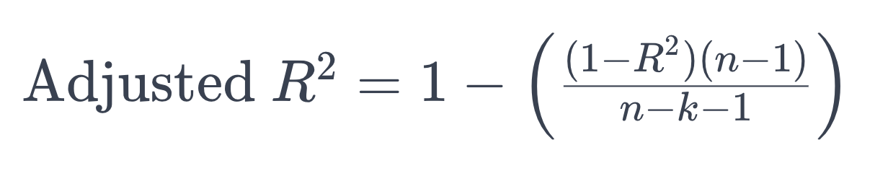
Adjusted R^2
Like R^2, but increases only if additional variables provide additional predictive power / penalizes the inclusion of irrelevant variables
Better than R^2 for selecting between models
n = sample size
k = number of predictors

Slide 17
Multiple Regression

Slide 18
No controls = No science
Plant B grew 3 inches taller per month during the study and received 5mg more of the chemical being tested.
Did the chemical cause the growth?
Or was it the additional 10 hours of sunlight, 5 degrees of warmth, or both, or all of them AND the dosage???
Or what if dosage has a negative effect, but it’s overwhelmed by the effect of the additional sunlight and heat?
Plant | Dosage | Growth | Sun Hours | Temperature
A | 50mg | 6 inches/month | 300 | 75
B | 55mg | 9 inches/month | 310 | 80

Slide 19
But…in real life / business / social sciences we often can’t run controlled experiments
We don’t have the luxury of controlling certain factors like we would if this were chemistry. Consider the question of stimulus spending efficacy during a recession…Does stimulus spending decrease unemployment?
Country | Unemployment Rate | Interest Rate | Stimulus Spending | Shared Currency
US | 7 | 1 | 700b | 0
UK | 10 | 2 | 200b | 0
France | 13 | 1 | 500b | 1
Germany | 5 | 0.75 | 100b | 1

Slide 20
Multiple Regression = Statistical Controls
Kind of like converting prior table into the table below (setting all of each country’s attributes as the same, except for what we’re attempting to calculate, for each variable)
Country | Unemployment Rate | Interest Rate | Stimulus Spending | Shared Currency
US | 7 | 1 | 700b | 0
UK | 10 | 1 | 200b | 0
France | 13 | 1 | 100b | 0
Germany | 5 | 1 | 100b | 0
Unemployment = B0 + B1(Interest Rate) + B2(Stimulus Spending) + B3(Currency Type) + Error

Slide 21
Multiple Regression
Just like the simple regression model, but not so simple!
Instead of measuring a single independent variable’s impact on a dependent variable, we measure the impact of multiple independent variables (Xi…Xn)
Now here’s the cool part…
…the coefficients (B1…Bn) are interpreted as the impact of each variable upon the dependent variable, holding all the other included variables “constant”

Slide 22
Interpretation
B0 = Constant (Do not interpret without a good reason, nor should you remove it)
B1 = Effect of a single point increase in interest rates, excluding the impact of stimulus spending and currency unions
B2 = Effect of a single unit increase in stimulus spending, excluding the impact of interest rates and currency unions
B3 = Effect of being in a currency union on unemployment, excluding the impact of stimulus spending and interest rates
E = The difference between the predicted value and the actual value
Unemployment =
B0 +
B1(Interest Rate) +
B2(Stimulus Spending) +
B3(Currency Type) +
Error

Slide 23
Understanding Regression Output
Coefficient(s): The relationship between the X variables and Y variable (holding other variables constant*)
R^2: The percentage of variation in Y explained by X
Adjusted R^2: R^2, but penalized for the inclusion of potentially irrelevant variables
P-Values: The p-value associated with the null-hypothesis that the regression coefficient is actually equal to zero (meaningless)
Confidence Intervals: Bands around which we can be 95% confident the true value is***

Slide 24
Regression Assumptions
There are several assumed conditions underlying regression analysis.
If the conditions of these assumptions are not met, the regression model will provide inaccurate estimates.
It is CRITICAL to assess each assumption and make adjustments / corrections.

Slide 25
Assumption 1
THIS DOESN’T MEAN WHAT IT SOUNDS LIKE IT MEANS!
REGRESSION CAN HANDLE NON-LINEAR RELATIONSHIPS
It basically means that B values cannot be transformed in any complex way
Kind of ignore this because it’s confusing
Model is linear (in parameters)

Slide 26
Linear in Parameters vs Variables
Linear regression does not require that the relationships between X’s and Y we’re estimating be linear.
OLS methods allow us to fit all sorts of non-linear relationships between Y and Xi
We do this by transforming variables and/or using alternative functional forms
The LINEAR part of linear regression is referencing the betas / coefficients
Y = B0 + Labor^B1 * Capital^B2 = NO GOOD
Sometimes logarithms solve this issue
Y=(Labor^B1)*(Capital^B2) = ln(Y) = B1(ln(Labor) + B2(ln(Capital)) = Fine

Slide 27
Assumption 2
No irrelevant variables included
No relevant variables excluded
Functional form is based on logic and theory
Correct Specification

Slide 28
Independent Variable Selection - Theoretical
Fundamental facts and logic: What variables do we know for sure help determine the value of the dependent variable? Example: Price is important in determining demand for a good.
Theory: What variables does current academic / professional theory suggest are helpful determining the value of the dependent variable? Do a literature review!
Controls: What factors aren’t directly related to facts or theory, but rather additional factors likely to confound your results. Example: Rain probably impacts sales, but indirectly.
Experimental: What we’re testing / trying to prove. Example: Does X impact Y or not?

Slide 29
Selecting X Variables For Your Model - Technical
How do we select variables?
Signs / Direction: Does the direction of the variable’s effect make sense / match theory? Price increases are unlikely to cause quantity demanded to rise, so a positive relationship is a concern (though it may be fine!)
T -testing / p-value: Does the variable have any statistical significance? Variables are statistically significant if their p-value is below your selected alpha.
R^2 / Adjusted R^2: Does a variable’s inclusion raise or (lower adjusted) R^2? Higher = Better
AIC / BIC: Does a variable’s inclusion raise or lower AIC / BIC? Lower = Better
Bias: How much do other variables change in magnitude and direction when other variables are added / removed?

Slide 30
The Role of Theory
Foremost, variables should be selected on the basis of established factual relationships, such as the relationship between quantity demanded and price
Next include high-confidence theoretical variables, such as quantity demanded and local housing-starts
Variables required as part of the methodology and/or study specifics, such as before / after categorical variables, or seasonal variables
Finally, variables being tested
Don’t just maximize R^2!!! Logical and in accordance with theory is more important than good statistical test scores.
You might be able to maximize R^2 with a bad model. Remember, spurious results are bound to happen. At 95% confidence, 1 in 20 significant results will be actually insignificant.

Slide 31
Selecting X Variables For Your Model
Estimating sales at a car dealership
Theorize a general form equation (variables and signs/directions)
Sales = f(inventory +, pricing -, economic conditions *, competitor pricing +, advertising +, weather *, pandemic -, season or month *)
Find specific data and variables to operationalize your theory
Sold Units = f(Inventory at start of month, average difference of MSRP and sale price, local unemployment rate, average discount of MSRP and sale price (scraped from website), $ value of advertising budget, precipitation (rain or snow), month (all but one), and is the time period in question during the Covid pandemic.

Slide 32
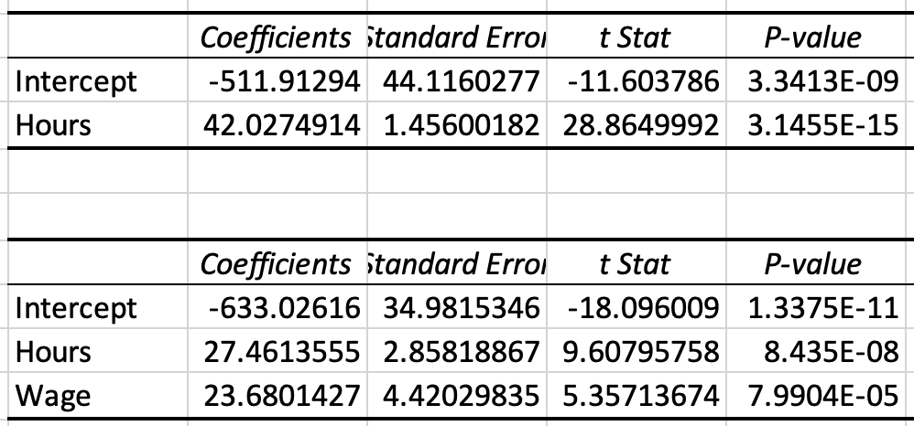
Consequences & Solutions of Omitted Variables
Detection
1) Logic / theory
2) Unexpected signs
3) Poor model fit
Consequences
1) Bias in coefficients (magnitude and/or direction)
2) Hypothesis testing is unreliable
3) Confidence intervals are unreliable
4) Low predictive power / inaccurate predictions
Solutions
1) Include the omitted variable in the regression - Duh!
2) Include a proxy variable if the actual variable cannot be included

Slide 33
Specification Error - Omitted X Variable
Domestic GDP = Consumption + (Investment) + Government Spending
Variable | Coefficient | Std. Error | T-Ratio | P-Value
Consumption | 1.35435 | 0.00699856 | 190.7 | 5.43-e^230
Investment
Government | 0.559162 | 0.0223322 | 25.04 | 7.57-e^64
Variable | Coefficient | Std. Error | T-Ratio | P-Value
Consumption | 1.18199 (lower) | 0.0149414 (higher) | 79.11 (lower) | 2.02-e^153 (higher)
Investment | 0.737060 | 0.0239936 | 30.72 | 7.34-e^78
Government | 0.431185 (lower) | 0.0392645 (higher) | 10.98 (lower) | 2.79-e^22 (higher)

Slide 34
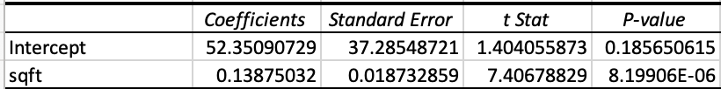
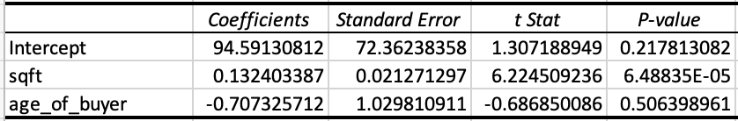
Consequences & Solutions of Irrelevant Variables
Detection
1) Logic / theory
2) T-test / P-value
3) Adjusted R^2
4) Impact on other coefficients
Consequences
1) Hypothesis testing is unreliable
2) Confidence intervals are unreliable
Solutions
Remove irrelevant variable(s) - Duh!

Slide 35
Specification Error - Included Irrelevant X Variable
Domestic GDP = Consumption + (Investment) + Government Spending
Variable | Coefficient | Std. Error | T-Ratio | P-Value
Consumption | 1.35435 | 0.00699856 | 190.7 | 5.43-e^230
Government | 0.559162 | 0.0223322 | 25.04 | 7.57-e^64
Variable | Coefficient | Std. Error | T-Ratio | P-Value
Consumption | 1.33539 (lower) | 0.00737851 (higher) | 181 (lower) | 1.48e-224 (higher)
Government | 0.553229 (lower) | 0.0258883 (higher) | 21.37 (lower) | 1.23e-53 (higher)
Poisson | 1.03594 | 2.27349 | 0.4557 | 0.6491

Slide 36
Stepwise Selection
Stepwise forward: Start with minimum number of variables needed and build up the model from there, adding more variables than you subtract
Stepwise backward: Start with the maximum number of (reasonable, logical, theoretical) variables and trim down the model from there, subtracting more variables than you add
Stepwise mixed: Both of the above
Comparison criteria: R^2 (+), Adjusted R^2 (+), AIC (-), BIC(-), T-Stats (+) / P-Values (-) of variables, signs of variables, F-Stat / P-Value of full model
THERE ARE MULTIPLE “RIGHT” ANSWERS
Report all results, range of results, transformations, test statistics, etc
MOST IMPORTANTLY, IF A VARIABLE HAS NO THEORETICAL VALUE, IT SHOULD NOT BE IN THE MODEL, REGARDLESS OF SIGNIFICANCE, FIT, ETC. AND IF A VARIABLE HAS THEORETICAL VALUE, IT SHOULD BE IN THE MODEL, REGARDLESS OF SIGNIFICANCE, FIT, ETC.

Slide 37
FUNctional Form
Linear: Y = B0 + B1x + e
Log-linear: ln(Y) = B0 + B1*x + e
Linear-log: Y = B0 + B1*ln(x) + e
Double-log: ln(Y) = B0 +B1*ln(x) + e
Polynomial: Y = B0 + B1*x + B2*x^2 + e
Inverse: Y = B0 + B1*(1/x) + e
Interaction: Y = B0 + B1*x1 + B2*x2 + B3*(x1*x2) + e

Slide 38
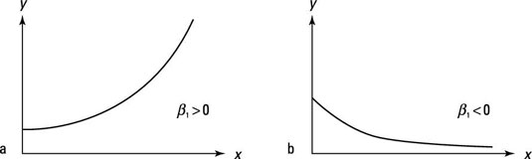
Log-Linear Model
Used to change non-linear equations into linear equations
Take the natural logarithm of the dependent variable
ln(Y) = B0 + B1*X1 + E
Coefficient interpretation: A one unit change in X leads to B * 100 percent change in Y

Slide 39
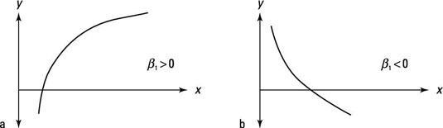
Linear-Log Model
Used to change non-linear equations into linear equations
Take the natural logarithm of the independent variables
Y = B0 + B1*ln(X1) + E
Coefficient interpretation: A one percent change in X leads to a B/100 unit change in Y

Slide 40
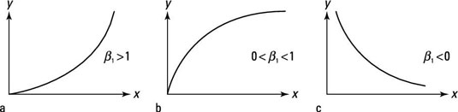
Log-Log
Used to change non-linear equations into linear equations
ln(Y) = B0 + B1*ln(X) + E
Take the natural logarithm of the dependent variable and independent variables
Coefficient interpretation: A one % change in X leads to a B percent change in Y = Elasticity

Slide 41
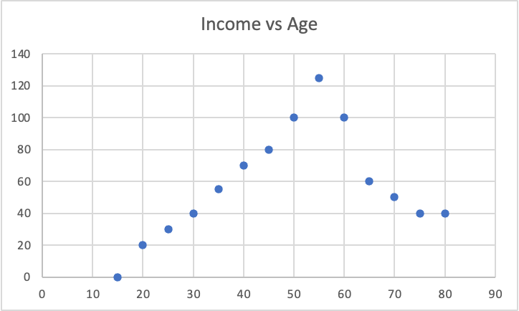
Polynomial / Quadratic Form
If a relationship between X and Y is concave or convex, a quadratic form may be needed
Y = B0 + B1(X1) + B2(X1^2) + E
Example: Income ~ Age
As age rises (16-60) earned income rises too, but at a certain point, people retire and their earned income falls (60-100…)
A properly formed model would include an age^2 variable
Income ~ Age + Age^2
Can be more than quadratic polynomial, depending on inflection points (X^2 = 1 inflection point, X^3 = 2 inflection points)
Interpretation is complex

Slide 42
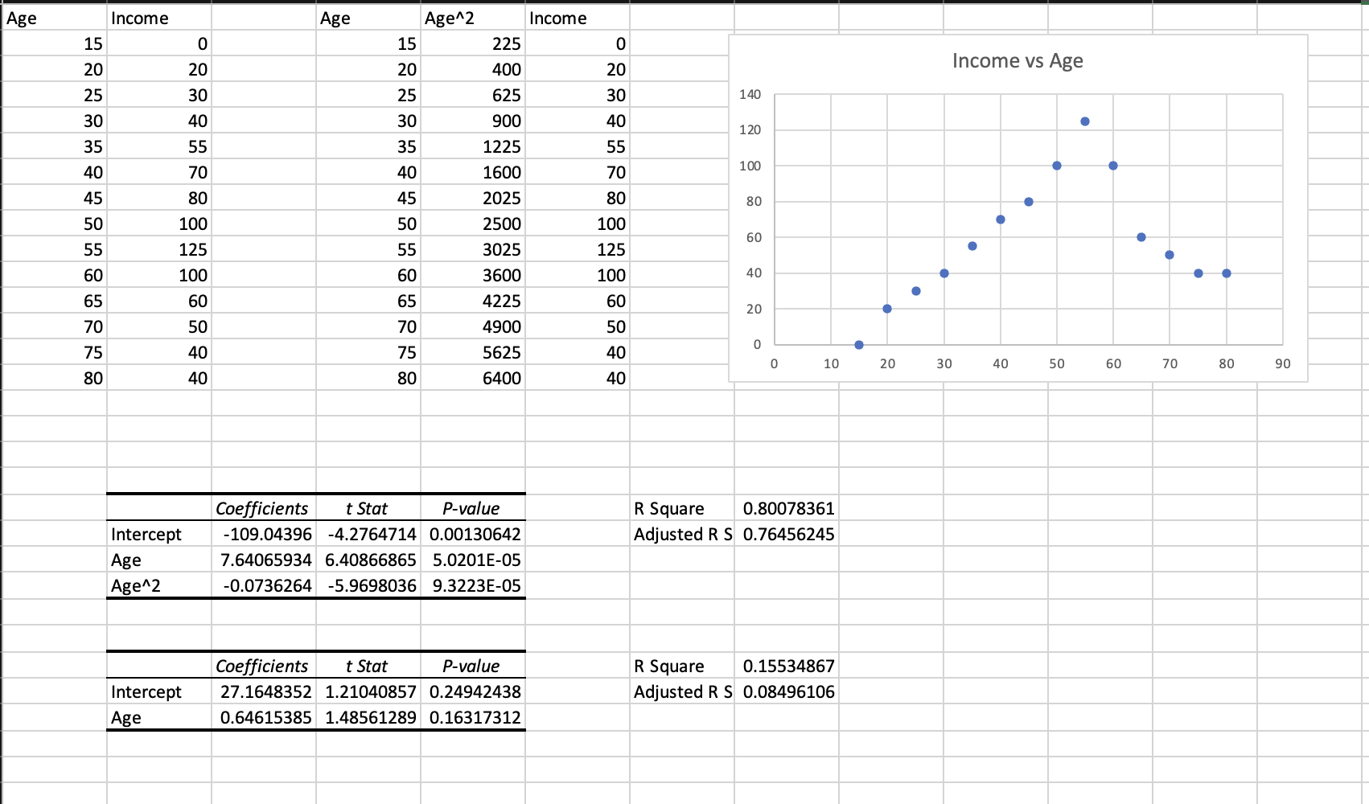
Polynomial / Quadratic Form

Slide 43
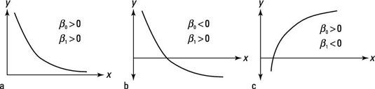
Inverse
Y = B0 + B1(1/X) + E

Slide 44
Consequences & Solutions of Incorrect Functional Form
Detection
1) Logic / Theory
2) Scatter plots of x vs y
3) Residual analysis*
4) Ramsey's RESET Test
Consequences
1) Biased coefficients
2) Hypothesis testing is unreliable
3) Confidence intervals are unreliable
4) Inaccurate predictions
Solutions
1) Try different functional forms
2) Transform variables

Slide 45
Ramsey’s RESET Test
Test for correct functional form and/or omitted variables
Provides hint of problem, but not many insights for solution
Step 1: Estimate a regression model
Step 2: Estimate another regression model using the Y-hat^2 and Y-hat^3 as additional independent variables
Step 3: Test the new variables for statistical significance. If they are significant, this points to the need for squared or cubic variables, or an alternate functional form

Slide 46
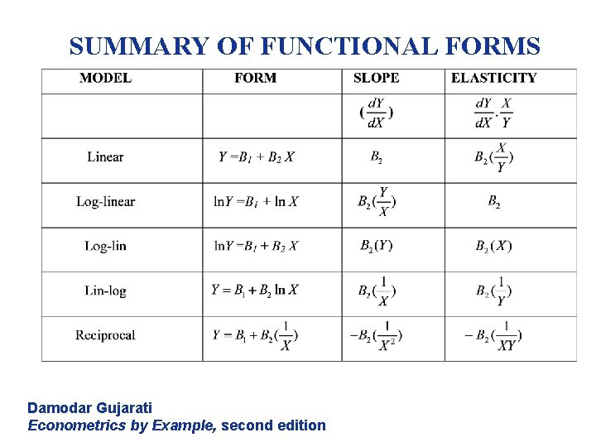

Slide 47
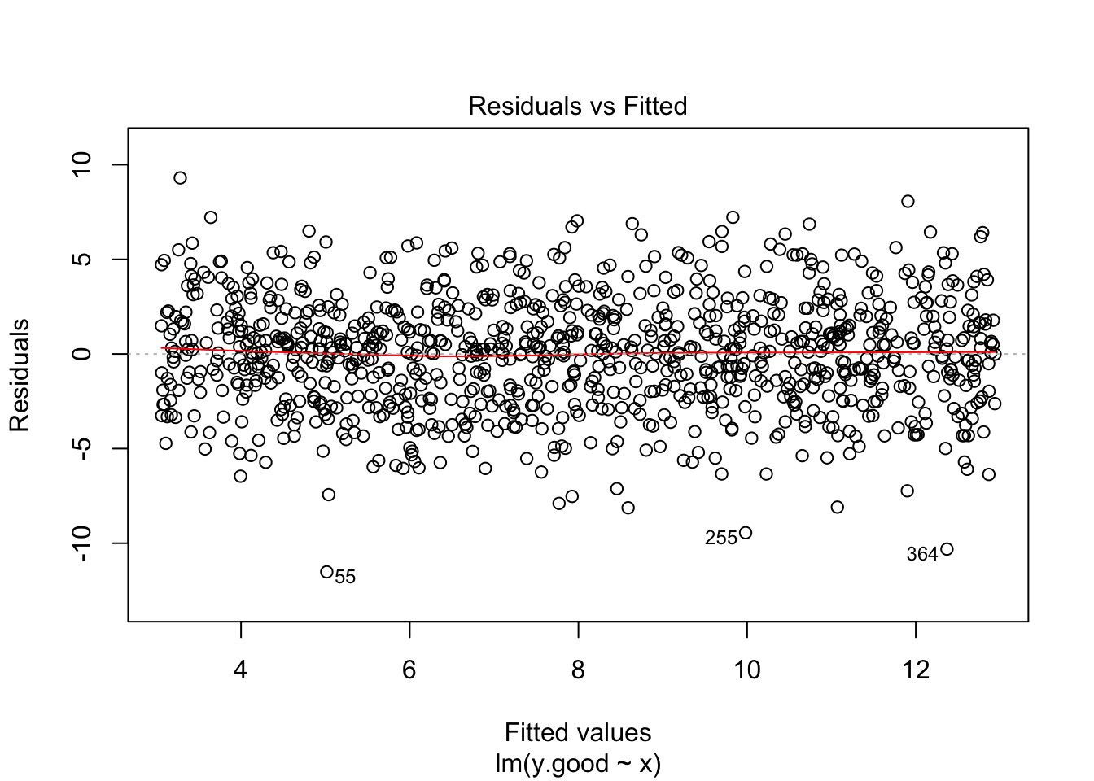
Assumption 3
Residuals are normally distributed and centered on zero

Slide 48
Errors / Residuals
In a correctly specified model:
1) Residuals should appear random
2) Residuals should be centered on zero - If they weren’t, the model would be systematically over / under
3) Residuals should be normally distributed

Slide 49
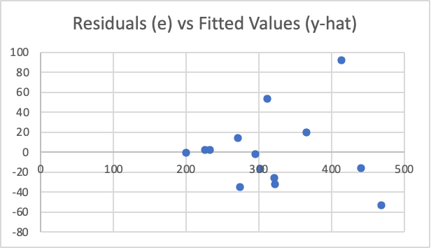
Assumption 4
Non-Heteroskedasticity Residuals
(Variance of errors is constant)

Slide 50
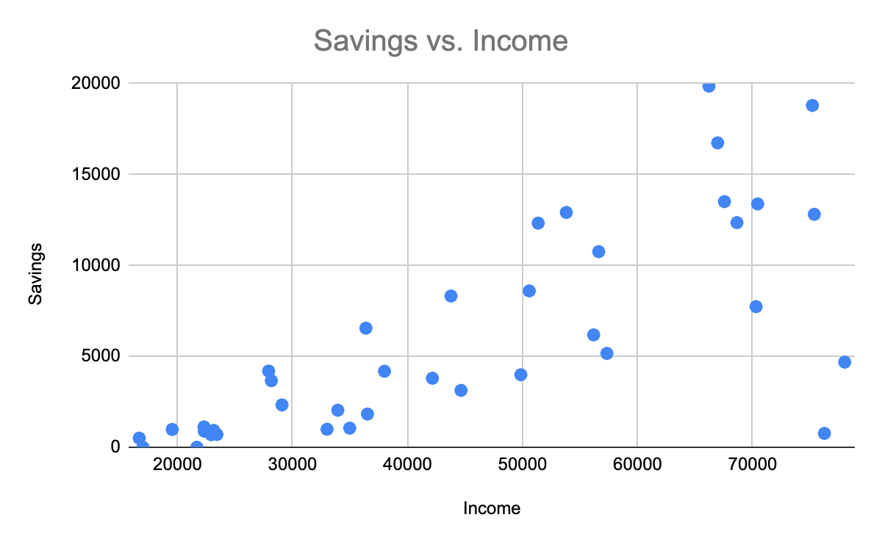
Heteroskedasticity in Savings Rates
In economics, we study consumption as a percentage of income, as a function of income.
The marginal propensity to consume is the percentage of income consumed vs saved.
Higher income households have more opportunities to save, but don’t necessarily save more than lower income households

Slide 51
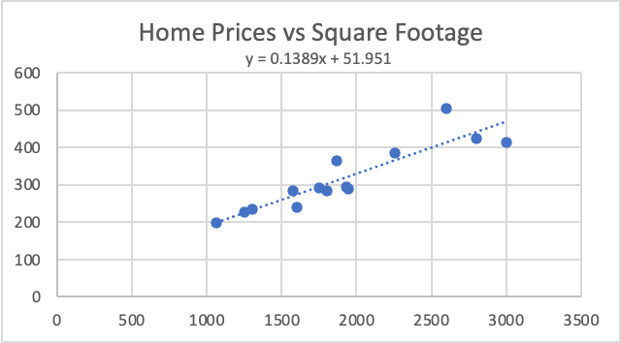
Heteroskedasticity

Slide 52
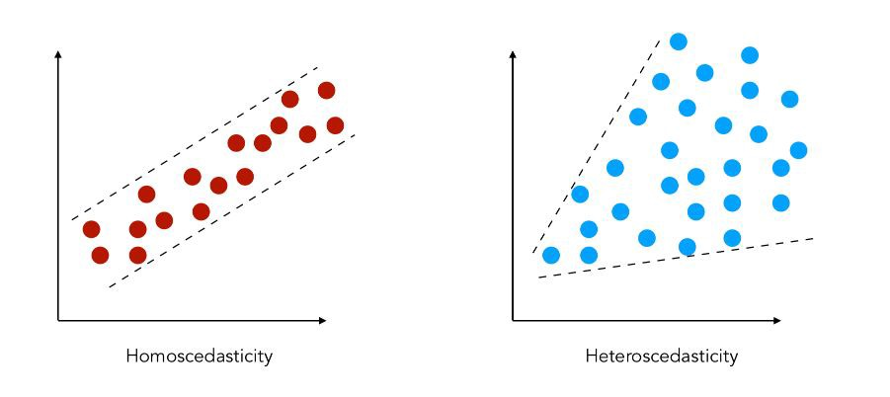
Assumptions: Homoscedasticity

Slide 53
Consequences & Solutions of Heteroskedasticity
Detection
1) Plot residuals against fitted values and each x variable looking for spreading pattern
2) White test:
H0: Homoscedasticity
HA: Heteroskedasticity
Consequences
1)OLS regression is no longer minimum variance
2) Hypothesis testing is unreliable
3) Confidence intervals are unreliable
Solutions
1) Transform variables
2) Change functional form
3) Use WLS or GLS

Slide 54
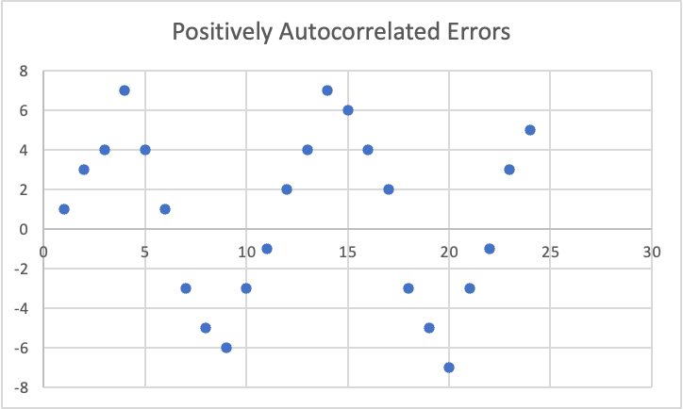
Assumption 6
Non-Autocorrelated Residuals
(Errors are not correlated with each other)

Slide 55
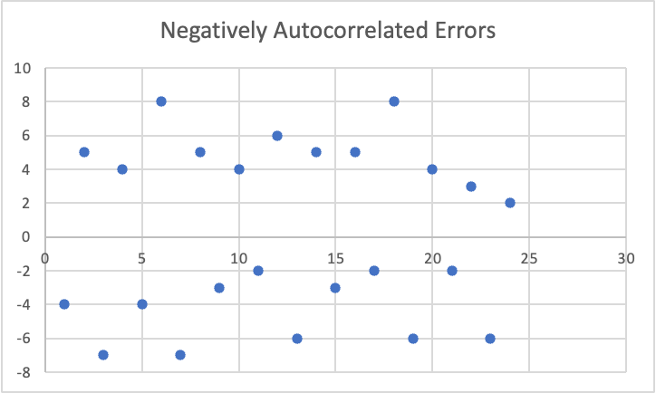

Slide 56
Consequences & Solutions of Autocorrelation
Detection
1) Plot residuals vs time and look for patterns
2) Durbin-Watson test*:
<2 = Positive Autocorrelation
2 = No autocorrelation
>2 = Negative Autocorrelation
Consequences
1)OLS regression is no longer minimum variance
2) Hypothesis testing is unreliable
3) Confidence intervals are unreliable
Solutions
1) Find and add an omitted variable
2) Change functional form
3) Use GLS or Newey-West standard errors

Slide 57
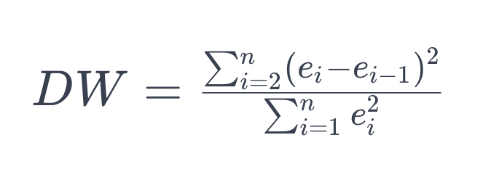
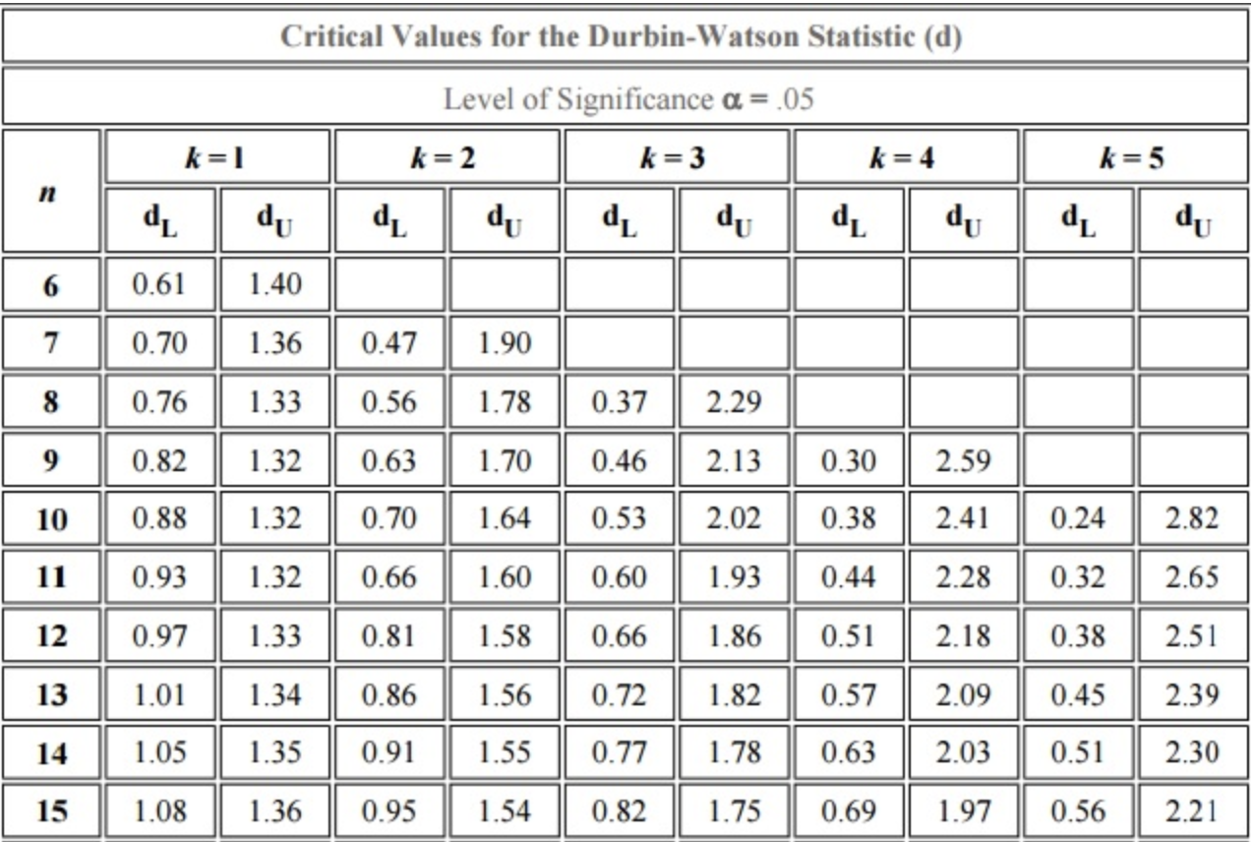
Durbin-Watson Test
1) Calculate DW statistic for given regression model.
2) Either use rough rules for cutoffs or lookup specific cutoffs from a Durbin-Watson statistical table.
Find critical values based on
1) Alpha
2) Sample size
3) Number of independent variables
DW-stat < dL = Positive autocorrelation
DW-stat > dU = Negative autocorrelation
DW-stat = 2 = No Autocorrelation

Slide 58
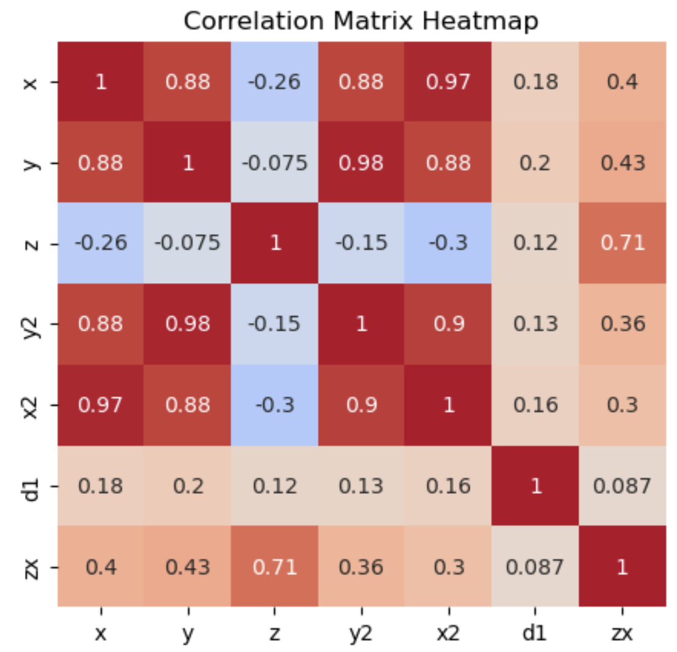
Assumption 7
No (Perfect) Multicollinearity
Independent variables are not (perfectly) correlated with each other

Slide 59
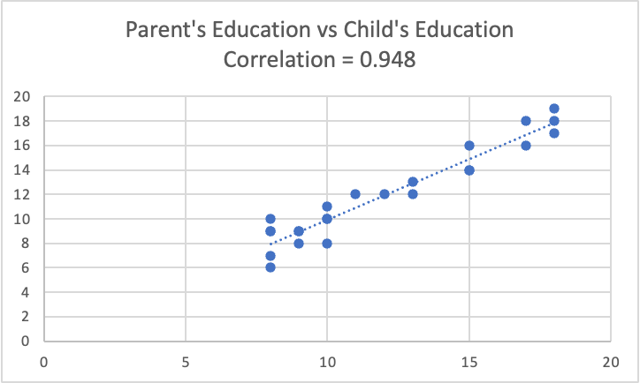

Slide 60
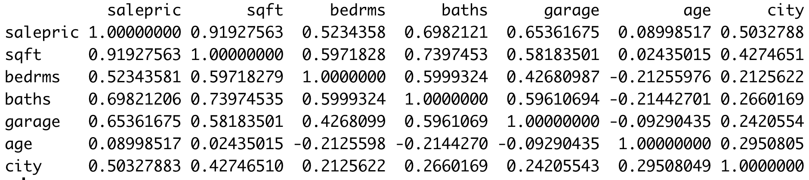
Finding Multicollinearity
Correlation Matrix
Run separate regressions with each independent variable used as the dependent variable vs all the other independent variables
VIF(X) = 1 / 1 - R^2 for each variable
VIF <1 = No problem!
1 < VIF < 5 = Minor problem
VIF > 5 = Large problem
Variance Inflation Factor

Slide 61
Assumptions: No (Perfect) Multicollinearity
Detection:
Variance inflation factor test, >5 = problem, > 10 equals large problem
Correlation matrix or plot of independent variables against one another (.8) or more is likely too much
Consequences of multicollinearity:
Hypothesis testing is unreliable
Confidence intervals are unreliable
With perfect multicollinearity, OLS doesn’t work at all.
Solutions:
Remove one or more of the affected variables from the model
Combine affected variables into a single variable (PCA, indices, etc.)
Do nothing!?

Slide 62
Outliers
Outliers do not violate any regression assumptions, but are still important to consider and potentially address

Slide 63
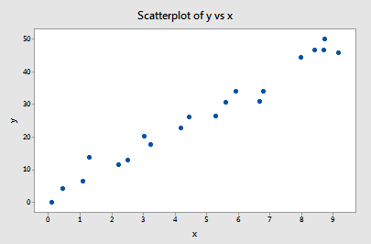
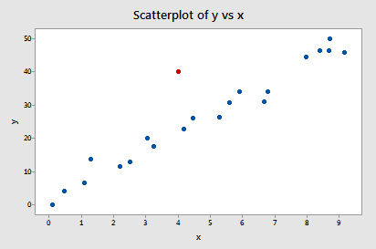
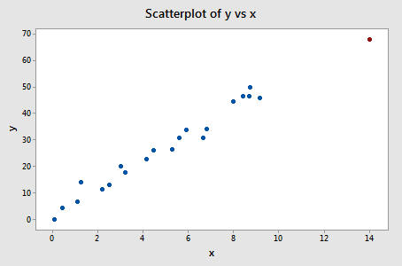
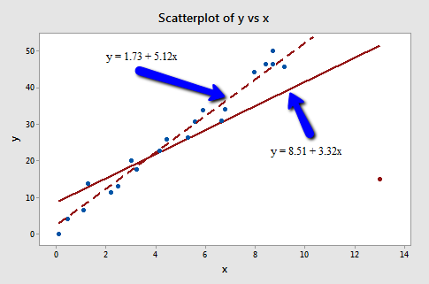
Outliers: data that does not follow the regression trend
Leverage: Data that has an extreme y value
Outlier + Leverage = Influence
High influence observations may be a problem.

Slide 64
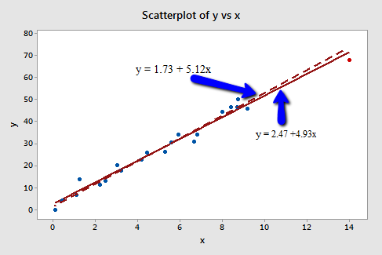

Slide 65
Outliers
Detection:
Residual Plot
Cook’s D
Observations with Cook’s D > 3 x Mean might be outliers
Observations with Cook’s D > 4/n might be outliers
DFBeta:
Shows impact of removing single value on regression equation
Consequences:
Estimates are pulled in the direction of the outlier, possibly distorting the real signal being measured
Solution:
1) Drop outliers
2) Don’t drop outliers

Slide 66
Diagnostics Plots
Plot all X variables against Y: This helps us understand the relationship between variables and suggests the possible need for alternative functional forms and variable transformations
Plot Y-Hat against Y: This helps us see how accurate our model’s predictions are
Plot residuals against Y-Hat: This helps us assess many of our regression assumptions and detect outliers
Plot residuals against all X variables: This also helps us assess many of our regression assumptions
Plot residuals against time (if time-series): This helps us detect autocorrelation
Normal Q-Q Plot and/or Histogram of Residuals: This helps us see if residuals are centered on zero and normally distributed

Slide 67
Y
Y
X
X
residuals
X
X
residuals

Slide 68
Residual Analysis
1) Plot residuals vs fitted values
2) Plot residuals against independent variables
3) Plot residuals against time (for time-series data)
Look for patterns which may suggest:
Missing variables
Misspecification
Heteroskedasticity
Autocorrelation

Slide 69
Diagnostic Tests
There are several statistical tests used to test the assumptions in regression analysis.
Test | Purpose
F-Test | Overall Model Significance
T-Test | Individual Coefficient Significance
White and Breusch-Pagan | Heteroskedasticity
Durbin-Watson | Autocorrelation
Ramsey's RESET | Functional Form / Variable Selection
Variance Inflation Factor (VIF) | Multicollinearity
Shapiro-Wilk | Normality of Residual
Cook's Distance | Influence / Outliers

Slide 70
F-Test For Overall Significance
Used to test for the statistical significance of the entire model.
Tests the model vs a model with no independent variables
H0: B1 + B2 + B3…+ BN = 0
HA: At least one coefficient =/= 0
k = number of independent variables
n - k - 1 = degrees of freedom for the model
MSR: Mean Square Regression
MSR = SSR / k
MSE: Mean Square Error
MSE = SSE / n - k - 1
F = MSR / MSE

Slide 71
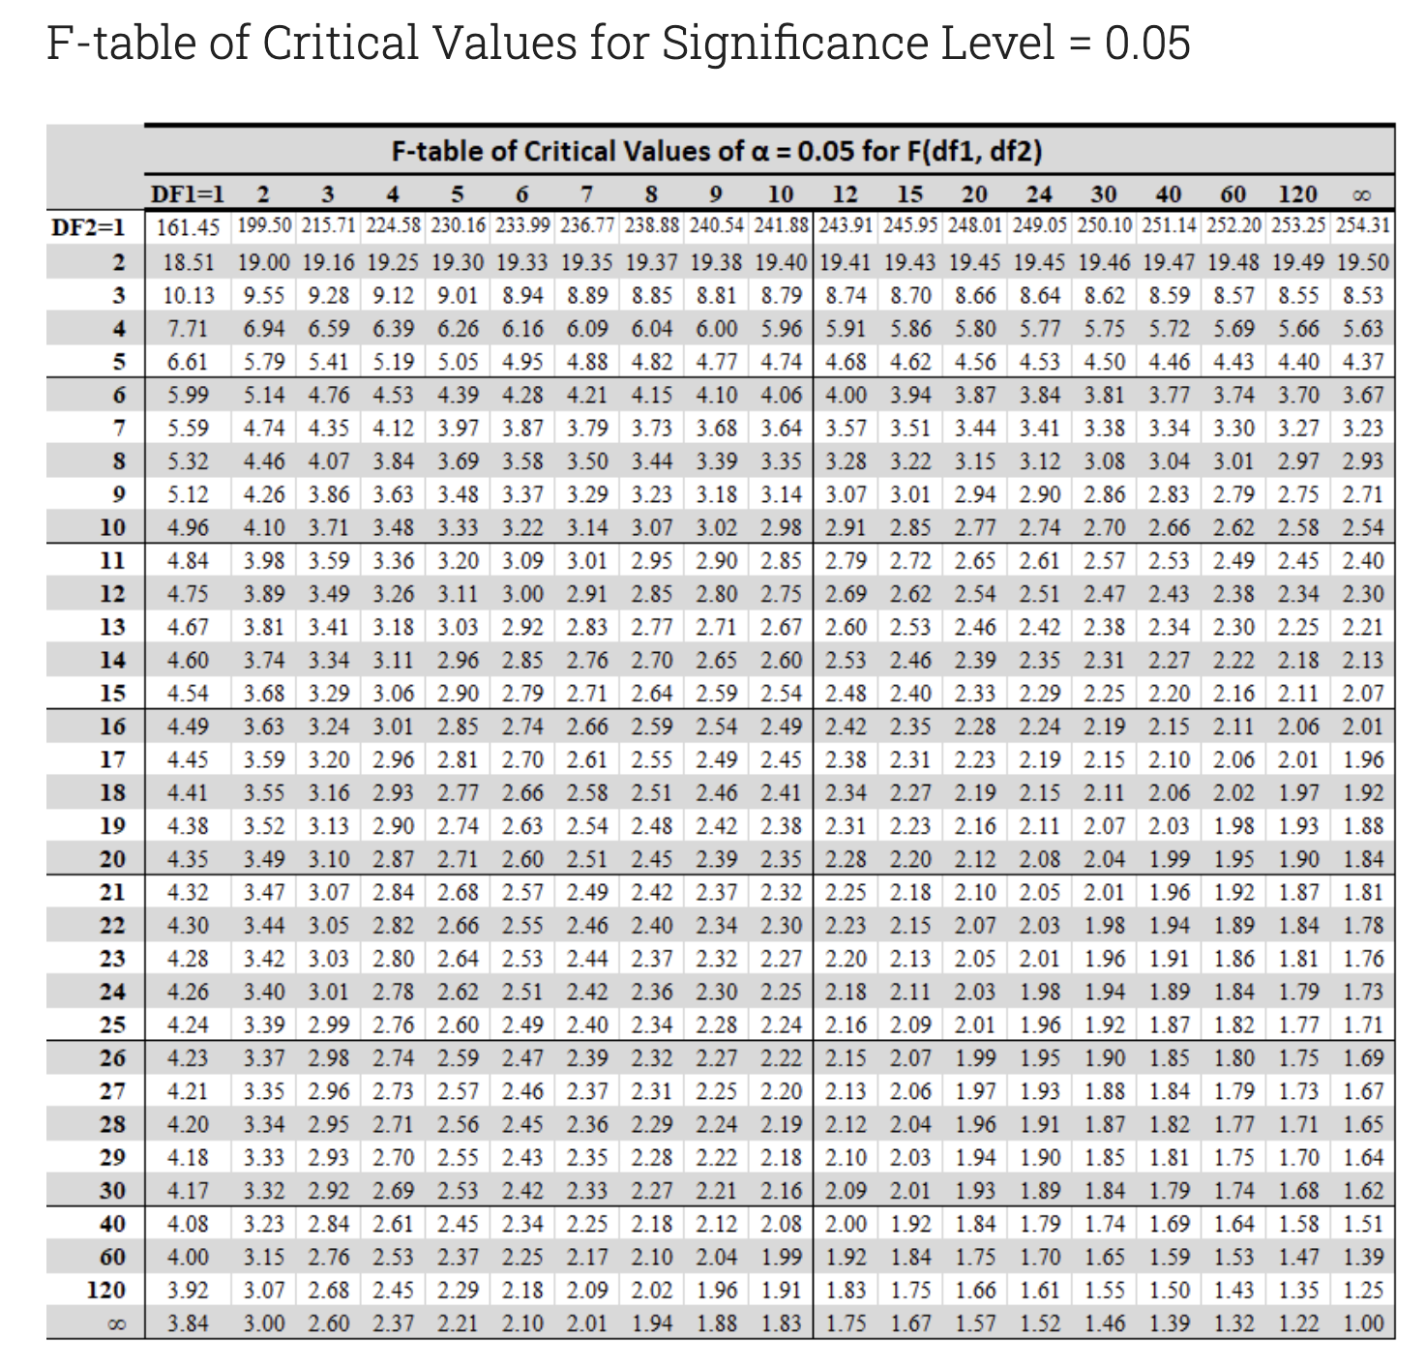
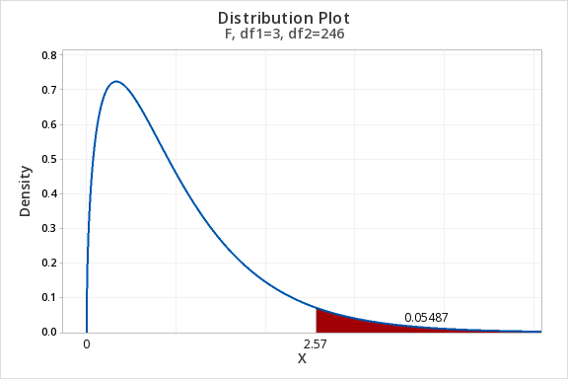
F Test / Table
Select table based on alpha
k = number of independent variables
DF1 / DFN = k
DF2 / DFD = n - k - 1

Slide 72
Dummy, Categorical, and Interaction Variables

Slide 73
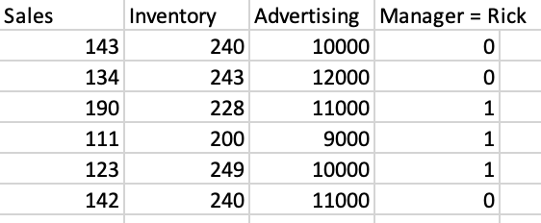
Dummy / Categorical Variables
Binary variables indicating:
Yes or No
On or off
True or false
Event or not event
Anything or not-anything
Create using 1 for whenever the condition is met and 0 for whenever it is not met

Slide 74
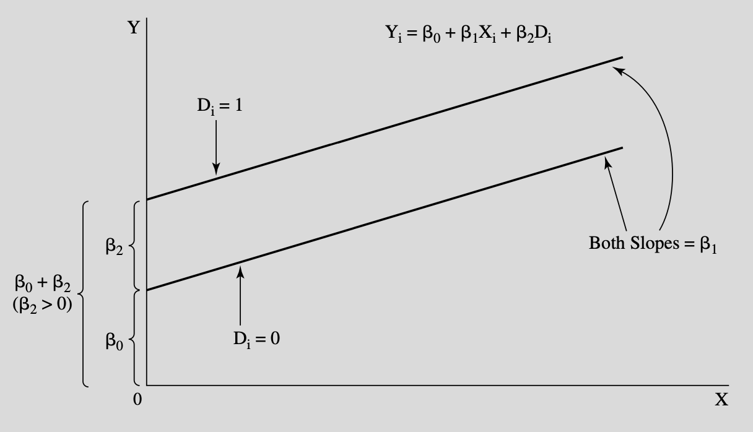

Slide 75
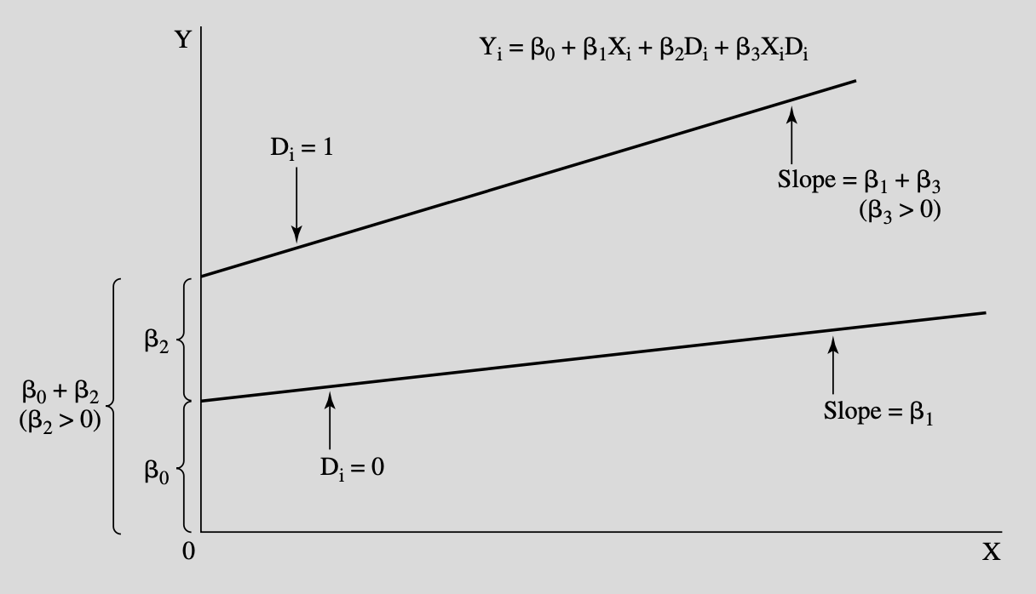
Interaction Terms
If you suspect that one variable’s effect is different under some conditions, create a new interaction variable by multiplying the two variables together and including it, alongside the original variables, in a new model
X1 = Gender (1 if male, 0 if female)
X2 = Experience (years)
B(X1*X2) = Slope dummy indicating a difference in the way that experience relates to wage for me
Must include both solo variables too

Slide 76
Periodic / Seasonal
Add one less variable than category
Example: Four quarters per year, so make three binary variables corresponding to any three quarters
Y = B0 + B1(Q2) + B2(Q3) + B3(Q4)
Interpretation:
Each beta coefficient is the difference between Q1 and the other quarters
B1 is the effect of being in the second quarter, relative to the first
B2 is the effect of being in the third quarter, relative to the first

Slide 77
Seasonal Variables
Y | X1 | Quarter | Q2 | Q3 | Q4
1 | 2 | 1 | 0 | 0 | 0
3 | 4 | 2 | 1 | 0 | 0
5 | 6 | 3 | 0 | 1 | 0
7 | 8 | 4 | 0 | 0 | 1

Slide 78
Seasonal Variables
How would you do this with months?
11 variables…

Slide 79
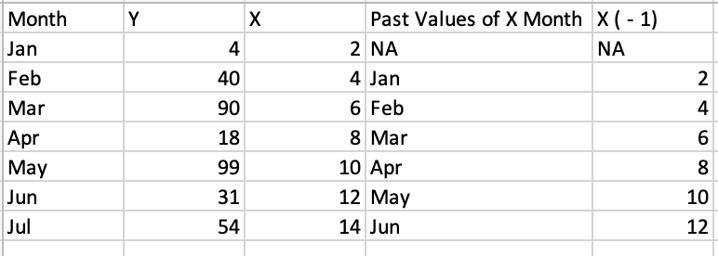
Lagging and Leading Variables
Want to know how past values relate to present/future values?
Examples: Marketing, monetary policy, etc.
Create a lagging or leading variable by shifting the variable forward or backward

Slide 80
Assessing Models
Compare models using:
Theory
F-Test of overall significance
R^2 (usually rises with new variables, even if bad)
Adjusted R^2 - Like R^2, but penalized for adding variables (higher = better)
AIC and BIC tests (lower = better)
Out of sample testing / cross-validation - Leave some data out of fitting process, then see how well that data is predicted by the model
Other research / literature review

Slide 81
R^2, Adjusted R^2, AIC, & BIC
Compare multiple models with the same dependent variable only. If you transform the dependent variable, you cannot compare using the criteria below:
R^2: Higher is better (but be careful because more variables raises R^2)
Adjusted R^2: Higher is better (penalizes for irrelevant variables)
Akaike Information Criterion (AIC): Lower is better
Bayesian Information Criterion (BIC): Lower is better

Slide 82
Sensitivity Analysis & Full Reporting
Honest research likely requires publishing the results of many models
Summarize the coefficients, providing averages, ranges, or just a table of results
Create separate models to address different deficiencies and report their strengths and weaknesses.
Don’t hide methods or weaknesses.

Slide 83
Parsimony and Occam's Razor
Less is better, all things being equal
An equally effective model with less complexity is likely superior for practical and philosophical reasons
Overfitting: Creating a model so specific that it is perfect for describing the dataset used to train the model, but has much less value when tested “out of sample”
Less specificity means less chance of overfitting

